Slide 1

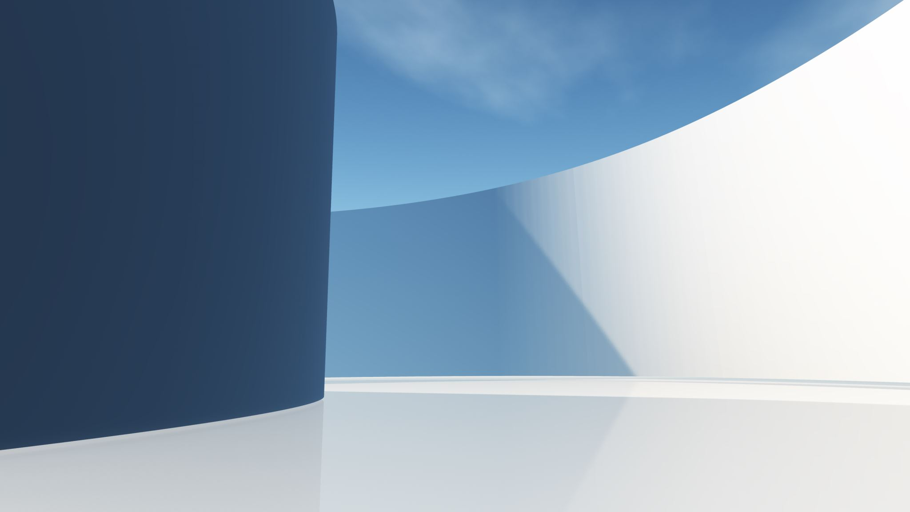
MOBILE APP DEVELOPMENT
PRESENTATION TOPIC:
VIRTUAL WARDROBE APP
“CLOTHING APP”

Slide 2
INTRODUCTION
Title: Clothing App
Subtitle: A user-friendly application to manage and explore different dress categories.
Overview:
Objective: Create an application for adding and browsing traditional and western dresses.
Technologies: Kotlin, Jetpack Compose, Navigation, Camera and Gallery Intents.

Slide 3
PRESENTED BY
SAHER IQBAL

Slide 4
SYSTEM DESIGN
Architecture Overview:
Components: MainActivity, Composables, Navigation.
Flow: User navigates between screens, adds dresses via camera or gallery.
Diagram:
Include a high-level architecture diagram showcasing the relationship between the MainActivity, Navigation, and various Composables.

Slide 5
IMPLEMEMTATION:
Main Components:
MainActivity: Handles navigation and permissions.
AppNavigation: Manages navigation between screens.
WardrobeScreen: Displays options for adding dresses and navigating to categories.
Key Code Snippets:
Initialize Camera and Gallery launchers.
Request permissions.
Navigation setup.

Slide 6
ClothingAppScreen: Displays a "Get Started" button to navigate to the WardrobeScreen. WardrobeScreen: Buttons for "Traditional", "Western", and "Add More Dresses". Dialog for selecting Camera or Gallery. NavigationScreen: Lists dress categories with navigation buttons.
FUNCTIONS

Slide 7
WORKING
User Flow:
Start from ClothingAppScreen.
Navigate to WardrobeScreen.
Add dresses using Camera or Gallery.
Browse dress categories.
Visuals:
Screenshots or mockups of each screen.
Code Integration:
Example of Camera and Gallery intents.

Slide 8
FUNCTIONALITY
Navigation:
Seamless navigation between different screens.
Camera & Gallery Integration:
Capture or select images to add dresses.
Dress Categories:
Traditional and Western dresses displayed in respective screens.

Slide 9
CONCLUSION
Summary:
Developed a versatile clothing app with robust navigation and media integration.
Simplified user interaction with an intuitive UI.
Future Enhancements:
Enhance dress management (editing, deleting).
Integrate cloud storage for images.
Add more dress categories and details.

Slide 10
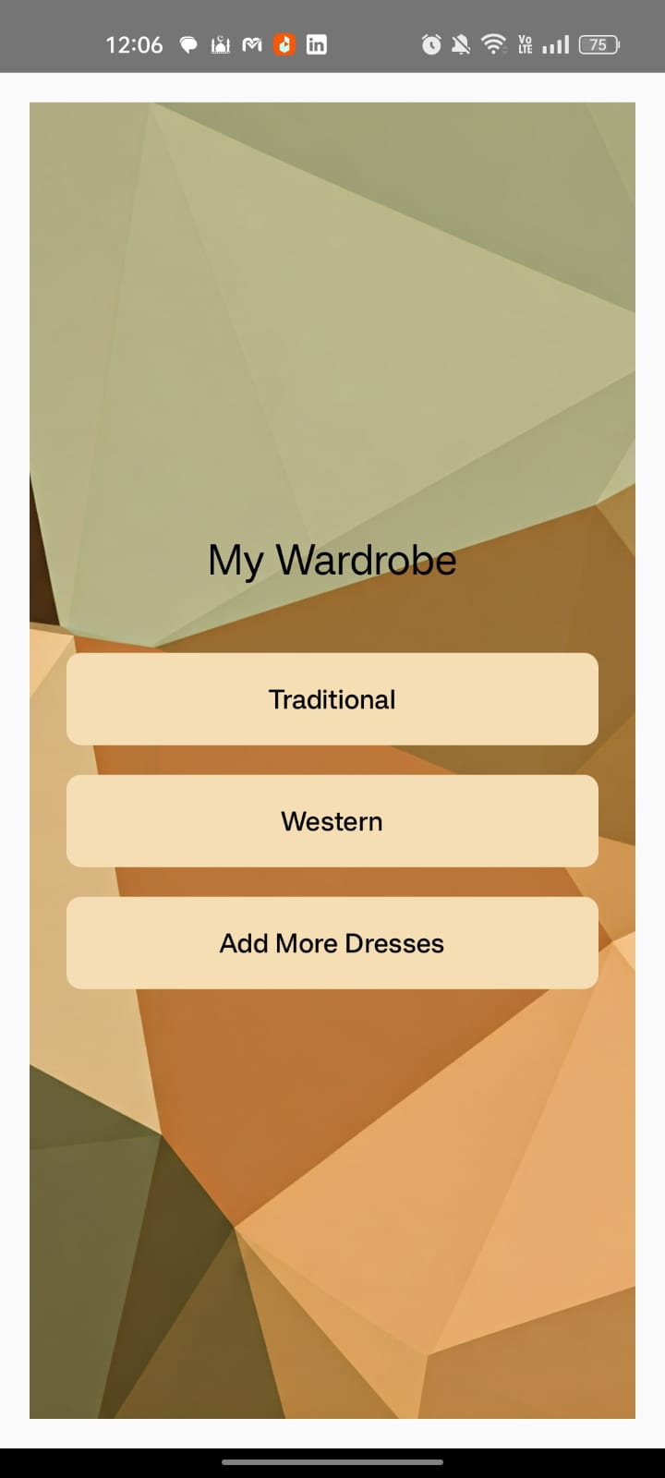
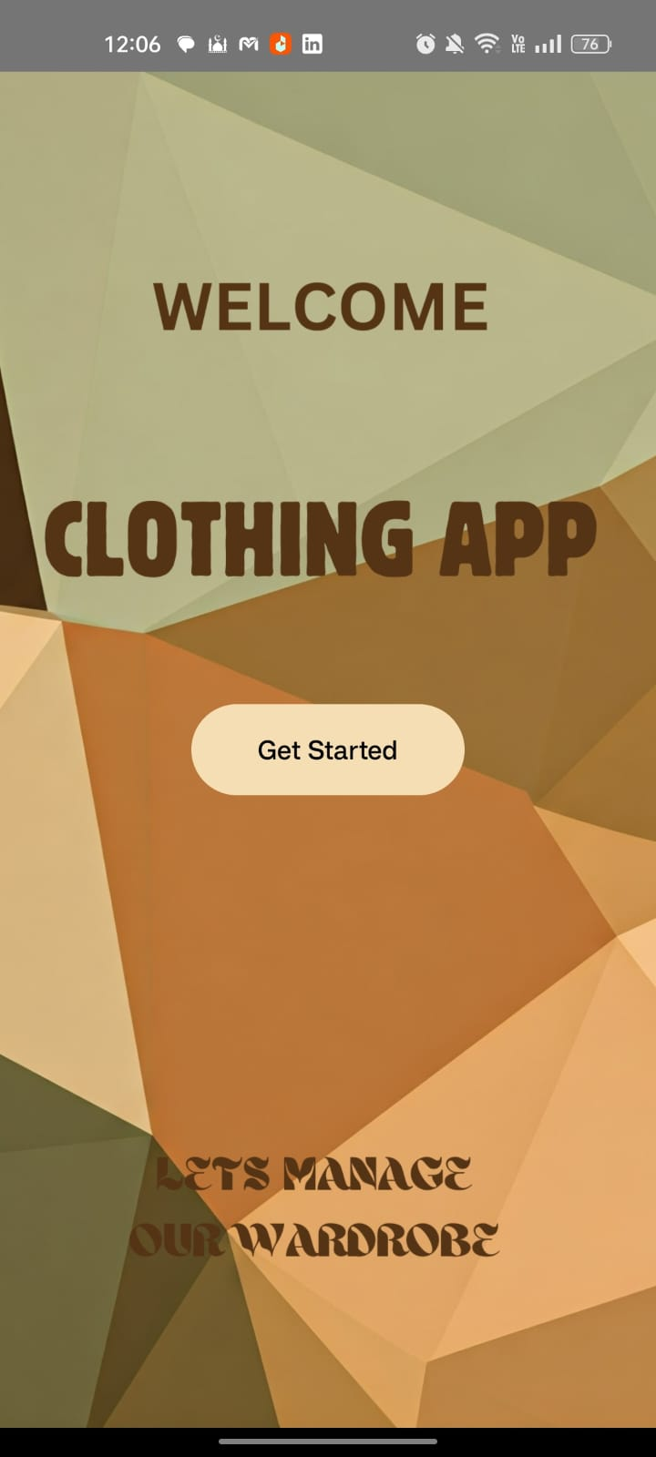
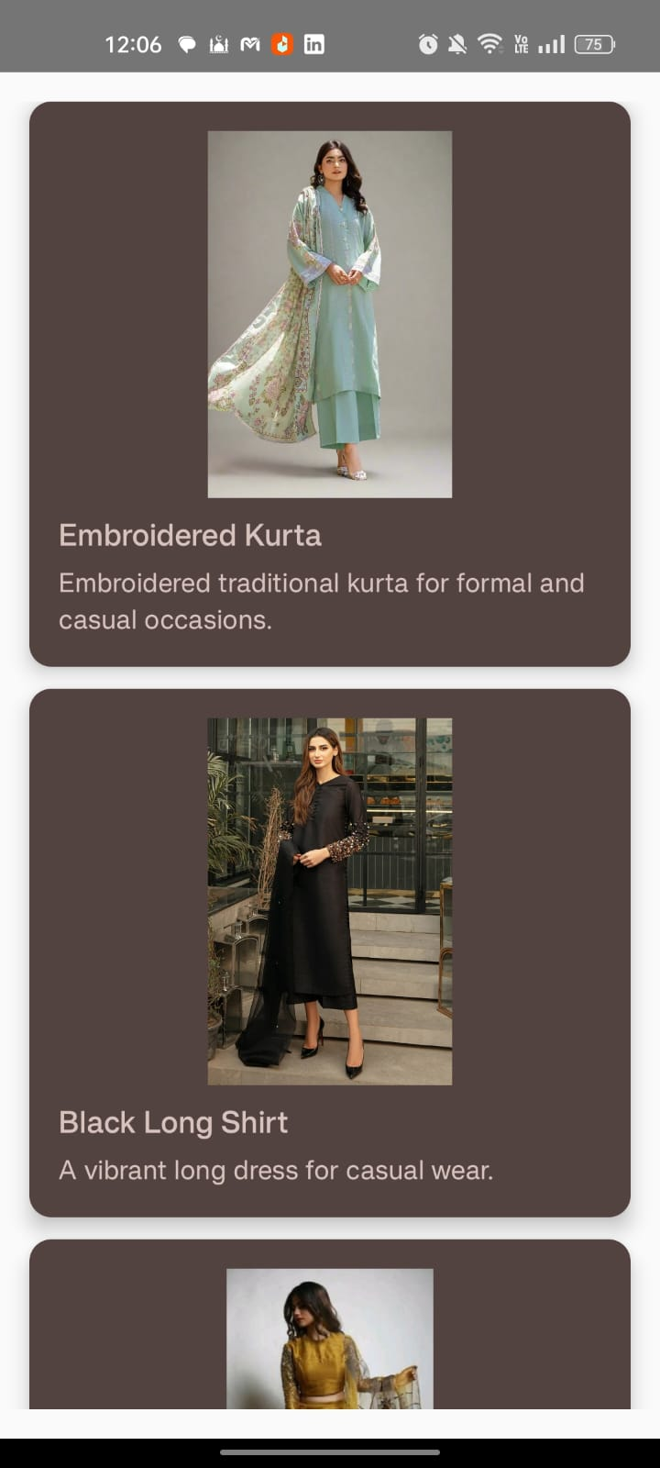
APP INTERFACE

Slide 11
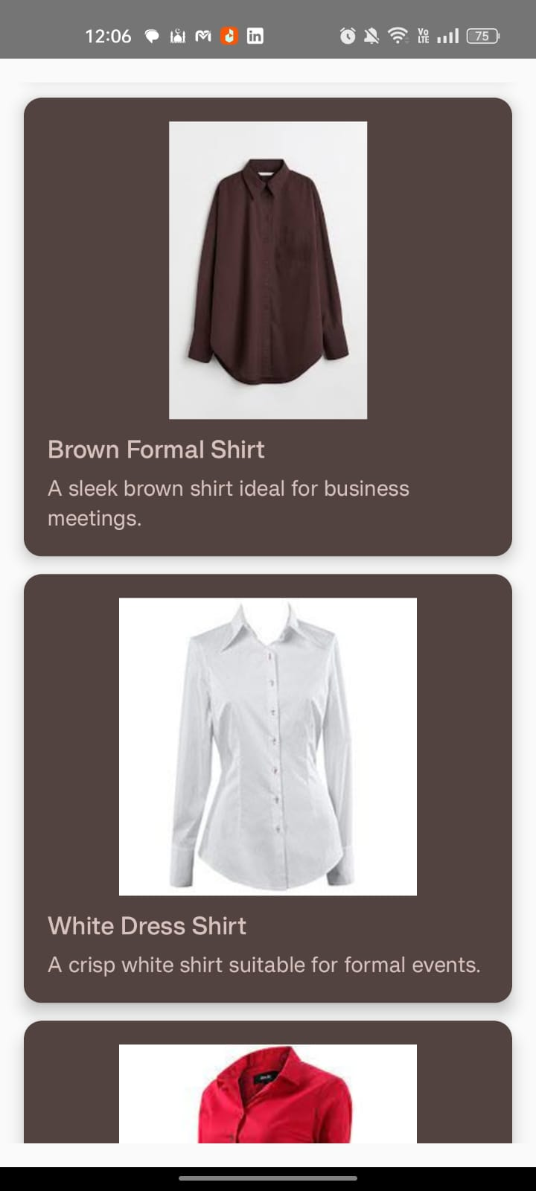
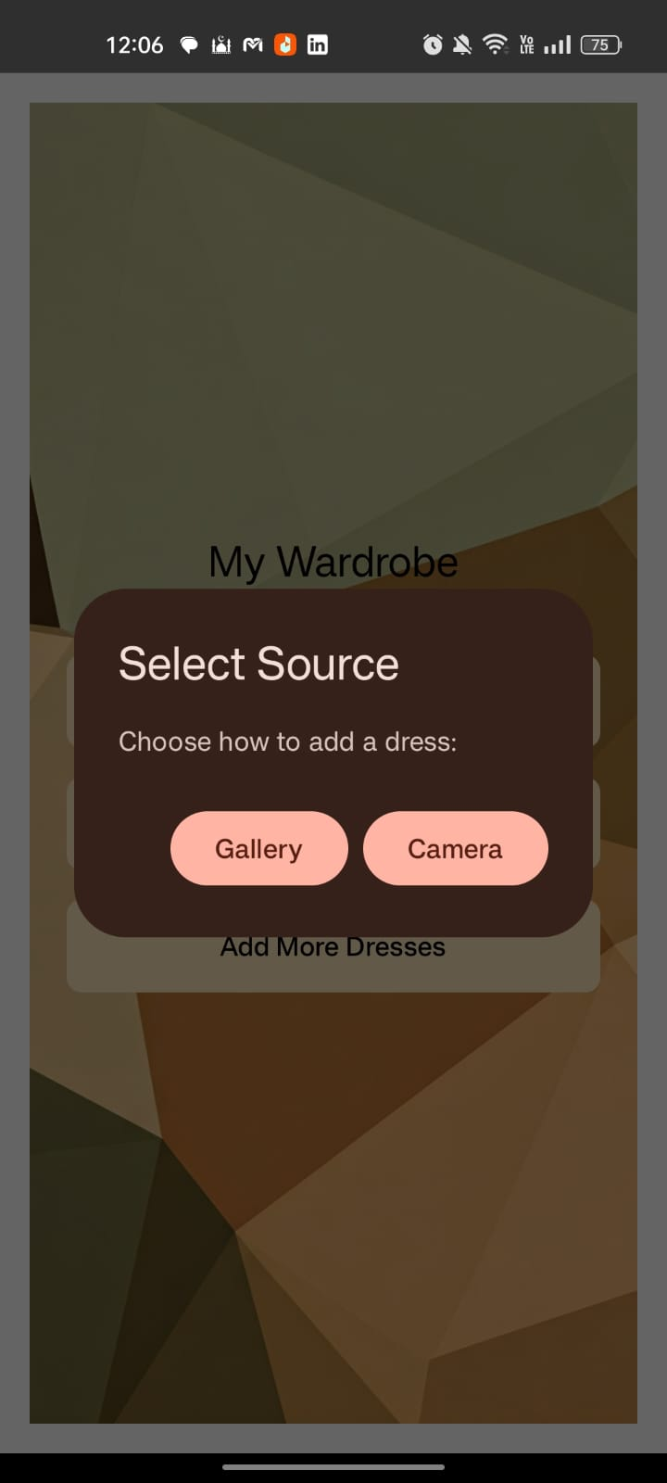
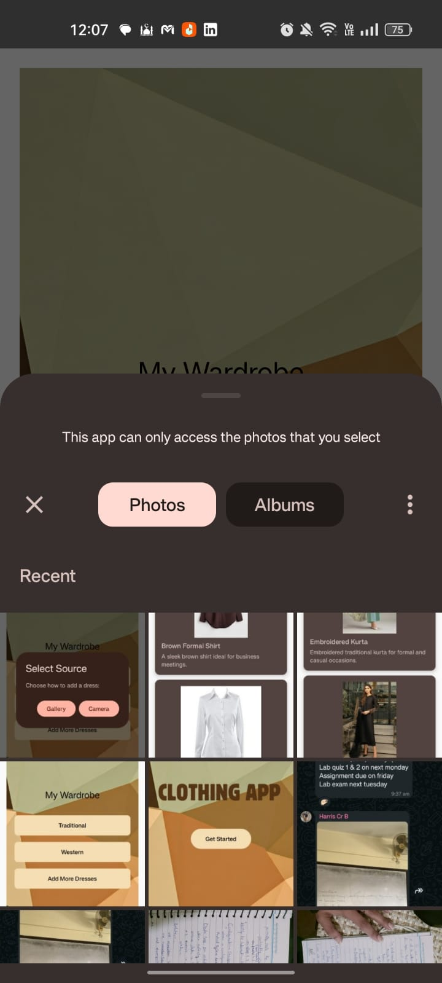
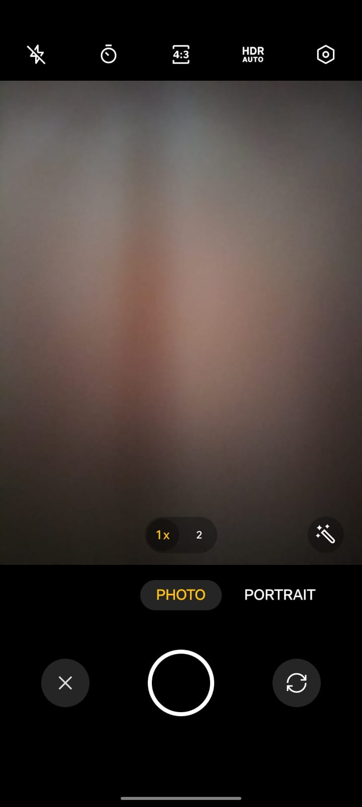
APP INTERFACE

